Slide 1


Slide 2
Adjectives

Slide 3
What is adjectives?
is a word/s that describes nouns

Slide 4
What is adjectives?
is a word/s that describes nouns
    people
    places
    things

Slide 5
Example:
The teacher is wearing a shiny pink blouse.

Slide 6
Example:
Noun
The teacher is wearing a shiny pink blouse.

Slide 7
Example:
Noun
The tecaher is wearing a shiny pink blouse.
Adjectives

Slide 8
Example:
It's a bright sunny day.

Slide 9
Example:
It's a bright sunny day.
Adjectives

Slide 10
Example:
Noun
It's a bright sunny day.
Adjectives

Slide 11
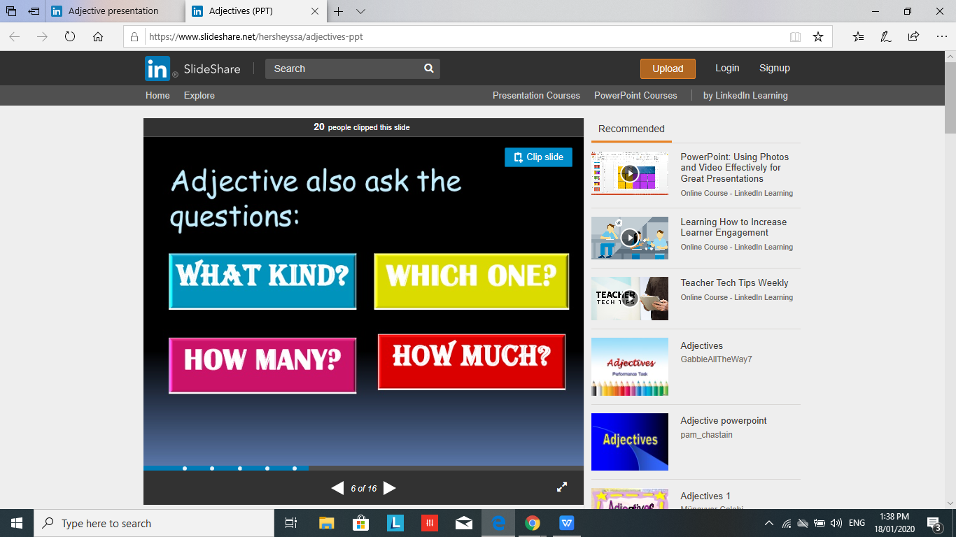
Adjectives also ask the questions:

Slide 12
Example:
Today is a warm day with hundreds of birds chirping in the clear blue sky.

Slide 13
What is Adjectives?
URL

Slide 14
Adjectives Order
URL

Slide 15
References:
https://www.youtube.com/watch?v=jSepkJV91mk
https://www.slideshare.net/hersheyssa/adjectives-ppt

